Slide 1
Enhancing Operational Efficiency and Driving Business Growth at JM Marketing
AVNISH JAJODIA
22F3001777

Slide 2
Business background
JM Marketing, established in the year 2000 by Ratan and Bharat Agarwal in Kolkata, is a trusted name in the aluminum sector. The company offers a diverse product portfolio, including aluminum panel sheets, sections, customized windows, doors, and laminates. Primarily serving the B2B sector with occasional B2C engagements, JM Marketing employs a skilled workforce of 20+ individuals. Over two decades, the company has built lasting partnerships with 50+ businesses, successfully delivered to 600+ locations, and catered to 500+ buyers. Committed to excellence, JM Marketing ensures premium quality by adhering to industry standards in manufacturing and transportation.

Slide 3
Challenges
JM Marketing is experiencing significant order delays, leading to customer dissatisfaction and order cancellations.
JM Marketing faces working capital blockage from unsold inventories, raising holding costs, while stagnant sales growth hampers business expansion.

Slide 4
DATA OVERVIEW
The data was gathered from the organization in an Excel file containing two sheets: Warehouse and Sales. The Warehouse data spans from July 2022 to July 2024, while the Sales data covers the period from August 2023 to July 2024.
Warehouse Data:
o SKU
o Brand
o Family
o Purchased From
o Rack No.
o Receive Date
o Receive Qty. (in kgs)
o Receive Pcs. (in units)
Sales Data:
o SKU
o Brand
o Family
o Sale Date
o Sale Qty. (in kgs)
o Sale Pcs. (in units)
o Remark

Slide 5
RESULTS AND FINDINGS
Sales Trend from August 2023 to July 2024.
Comparative Brand wise Sales for year 2023 and 2024.

Slide 6
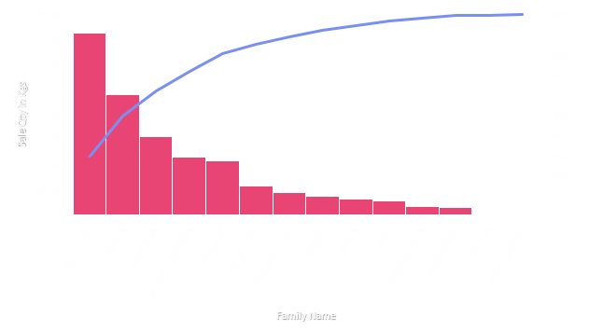
Brand wise unsold SKUs lying in the warehouse.
Comparative Family wise Sales for year 2023 and 2024.
Pareto Chart of Family wise Sales.

Slide 7
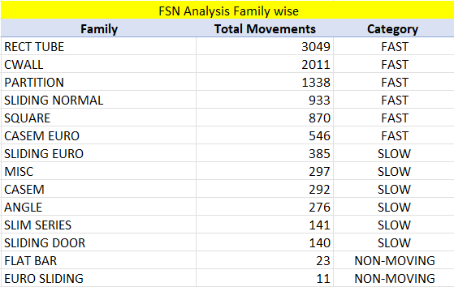
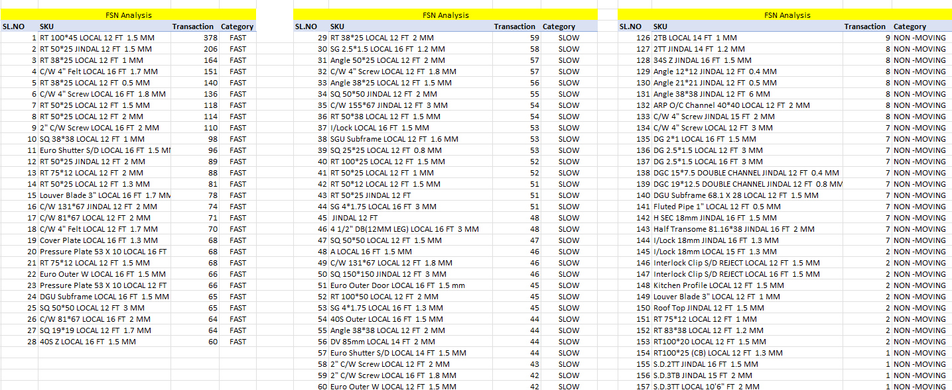
Family wise FSN Analysis.
SKU wise FSN Analysis.

Slide 8
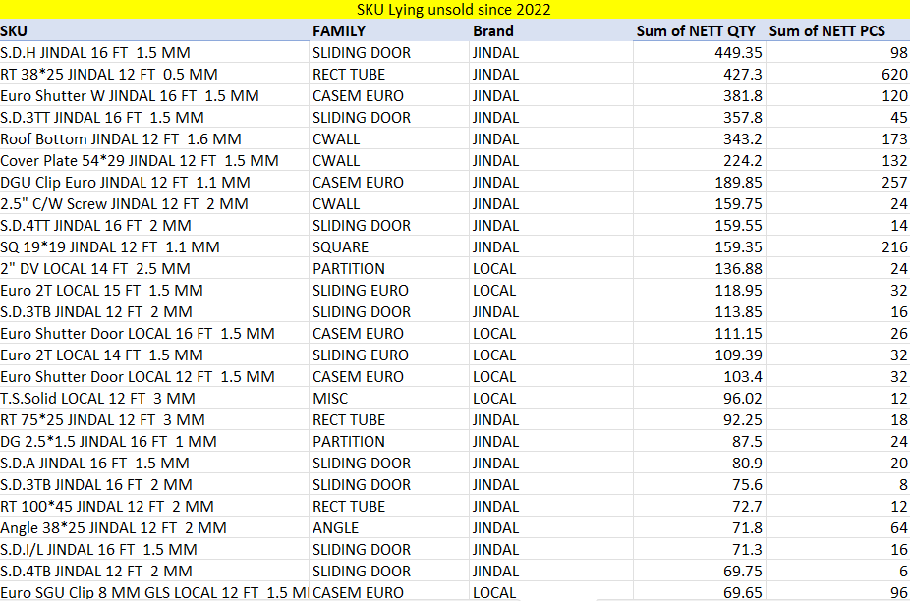
Trend on Net Quantity.
Dead Sock of JM Marketing since 2022.
Trend on Net Pcs.

Slide 9
RECOMMENDATIONS
It was recommended to stock more products from Hindalco and Alom brands, as significant growth in sales indicated a shift in customer preferences toward these brands.
The firm should prioritize high-performing families while avoiding investment in underperforming ones like FLAT BAR and EURO SLIDING to reduce working capital blockage and holding costs. Additionally, strategies such as targeted marketing and product enhancements are recommended to address stagnation in key families, boosting demand and overall sales growth.
It was advised to align the SKUs in the warehouse according to FSN (Fast, Slow, and Non-moving) categories to reduce order processing time and enhance customer satisfaction.
It was further recommended to dispose of unsold SKUs in the warehouse, either as scrap or at a discounted price, to reduce holding costs and recover tied-up working capital.
A shift toward weight-specific inventory management was proposed, as inventory growth is primarily driven by weight rather than volume. Developing weight-based warehousing strategies was recommended.
It is recommended that the firm increase its advertising budget to implement a targeted marketing strategy designed to distinguish itself from its competitors in the Lenin Sarani area of Chandni Market, Kolkata.

Slide 10

BDM DATA

